Slide 1
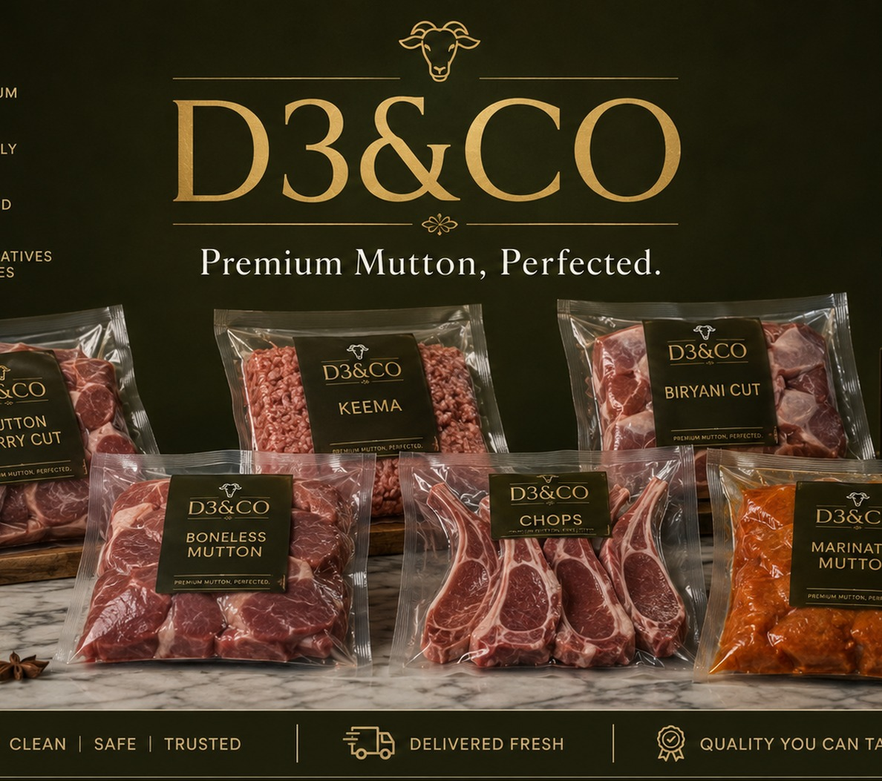
D3&CO
Premium Mutton, Perfected.
Investor Pitch Deck
Building India’s most trusted premium mutton brand through focused sourcing, hygienic processing, quick-commerce reach and premium offline stores.
Mutton-first launch
Omnichannel growth
Profit-focused model
August 2026
01

Slide 2
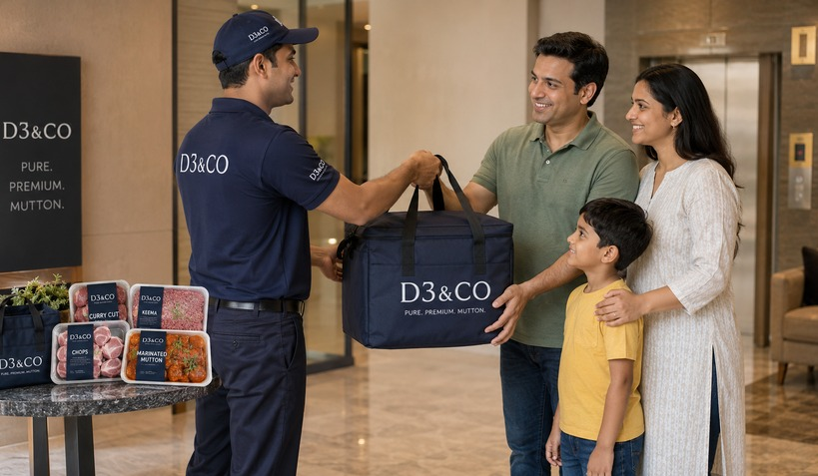
D3&CO
Problem
The mutton category is valuable, but trust is broken
01
Inconsistent quality
02
Low hygiene confidence
03
High price, low transparency
Unpredictable freshness, cuts, smell, fat ratio and weight accuracy.
Modern households want cleaner handling, packaging and temperature control.
Mutton is premium, but customers rarely see sourcing or quality proof.
D3&CO converts a fragmented purchase into a branded, trusted habit.
The first opportunity is not to sell every protein. It is to win one high-value category deeply: premium mutton.
02

Slide 3
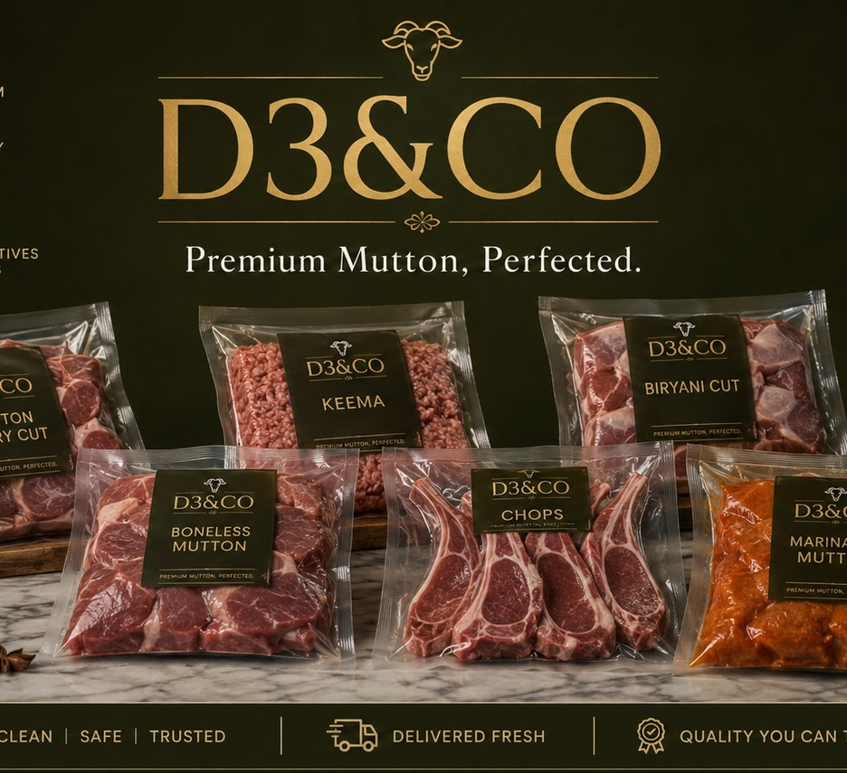
D3&CO
Solution
D3&CO: a specialist premium mutton brand
Start narrow. Win mutton. Expand after trust is established.
A mutton-first model lowers operational complexity, strengthens brand recall, simplifies procurement and creates clear premium positioning.
1 category
8–12
Lean hub
Initial focus
Launch SKUs
Model
mutton only
hero products
not heavy chain
Ethical supplier network and grade-based procurement
Expert cuts: curry cut, biryani cut, boneless, keema and chops
Hygienic processing, vacuum / chilled packing and visible quality proof
Own direct channel plus Zepto, Blinkit, Instamart and premium stores
03

Slide 4
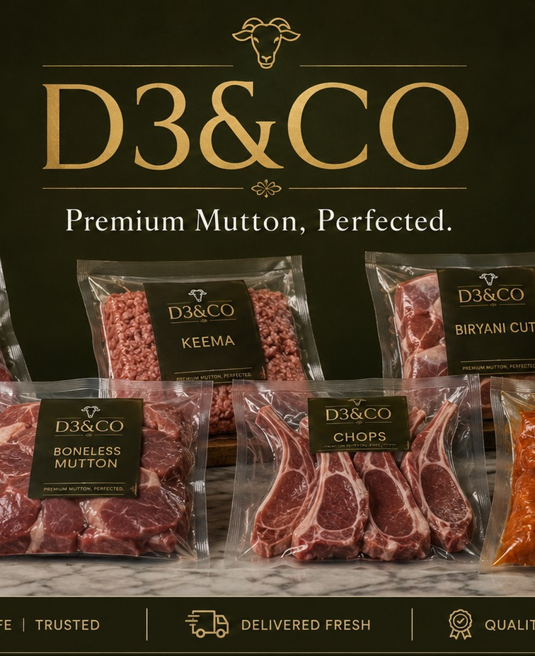
D3&CO
Products
Launch portfolio: 8–12 hero SKUs, not a scattered catalogue
SKU
Customer job
Strategic role
Curry Cut
Daily household cooking
High frequency
Biryani Cut
Weekend/family occasions
Higher basket
Boneless
Urban convenience
Premium margin
Keema
Quick cooking
Repeat demand
Chops
Premium celebration
Brand builder
Marinated Mutton
Ready-to-cook
Highest value-add
Product principle
Raw cuts drive habit. Premium and ready-to-cook products drive margin.
04

Slide 5
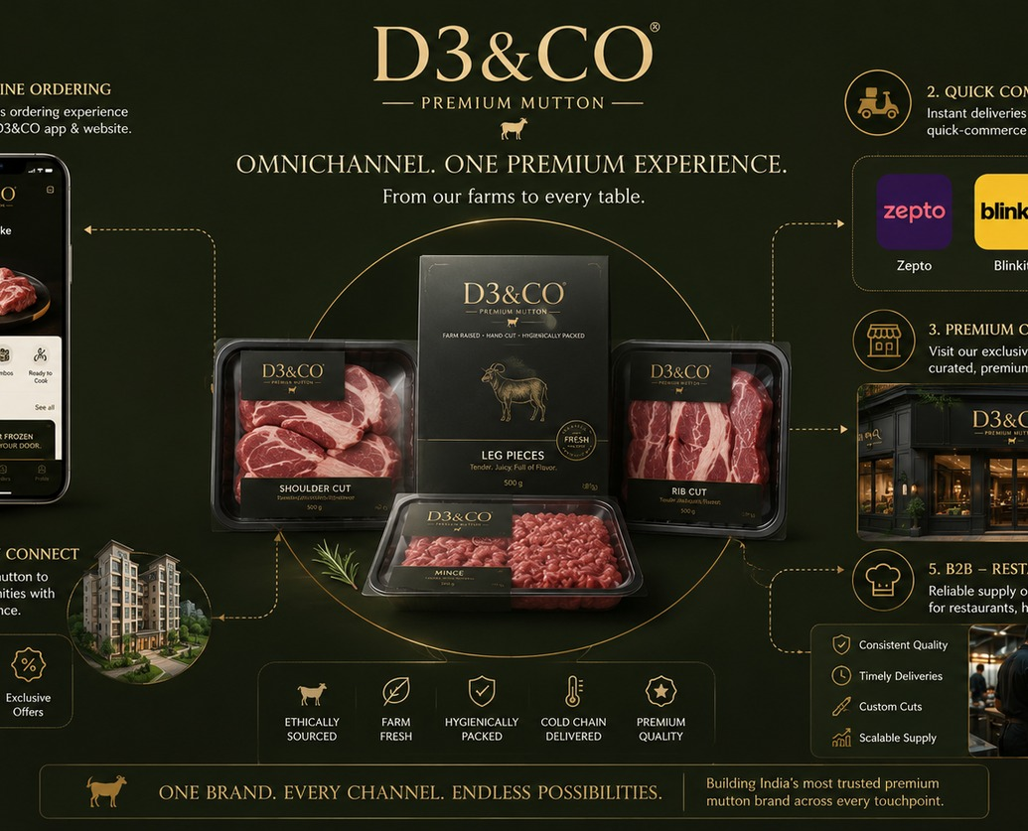
D3&CO
Channels
Omnichannel, but with each channel doing a different job
A
Own WhatsApp / website
B
Quick commerce
Highest margin, subscriptions, repeat purchases.
Zepto, Blinkit, Instamart for discovery and urgent needs.
C
Apartment communities
D
B2B supply
Low acquisition cost, dense delivery routes and trust building.
Restaurants, cloud kitchens and caterers for baseline volume.
E
Premium stores
F
Subscriptions
Trust, experience, walk-ins and local fulfilment hub.
Weekly/fortnightly mutton packs for loyal families.
Quick commerce acquires reach. Direct channels retain value.
05

Slide 6
D3&CO
Operating Model
Lean operating model designed for early profitability
01
02
03
04
05
Demand capture
Smart procurement
Processing hub
Omnichannel dispatch
Feedback loop
Pre-orders, platform demand, B2B standing orders
Buy close to confirmed demand, grade quality
Cut, pack, chill, label and dispatch
Routes, quick commerce, community drops, B2B
Repeat rate, SKU margin and wastage tracking
Core advantage: demand-led inventory
<4%
250g–1kg
M9–M12
Mutton is perishable and expensive. The model limits unsold stock through pre-orders, community drops, B2B baseline demand and a narrow SKU launch.
Target wastage
Pack sizes
Break-even
after month 6
channel-led
pilot model
06

Slide 7
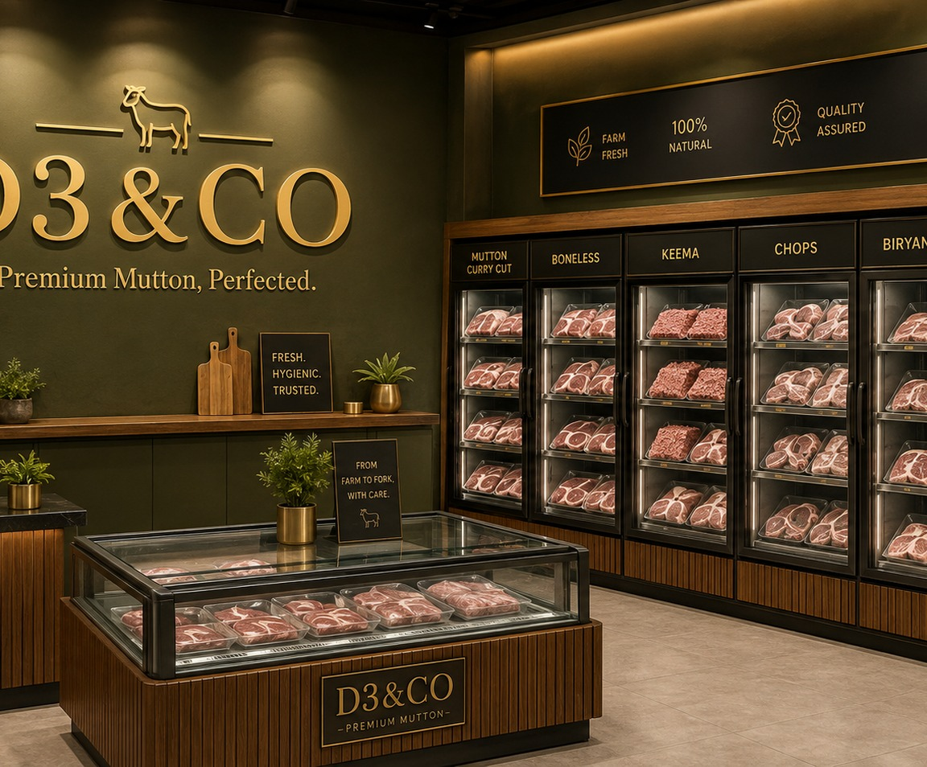
D3&CO
Retail
Offline stores become premium showrooms + micro-fulfilment hubs
Not a butcher shop. A premium mutton boutique.
300–700 sq ft format in premium residential zones
Glass-front chilled displays and visible hygiene standards
Acts as click-and-collect, walk-in sales and local dispatch hub
Supports higher-margin products: chops, boneless and ready-to-cook
Creates offline trust for online repeat orders
Trust
2–4 km
Phase 2
Store role
Hub radius
Launch
brand proof
local dispatch
after demand proof
07

Slide 8
D3&CO
Go-to-Market
90-day launch plan: prove one micro-market before scaling
Days 1–30
Days 31–60
Days 61–90
Setup & supply
Demand engine
Channel scale
Supplier tie-ups, FSSAI compliance, hub setup, packaging, 8–12 SKUs, first communities.
WhatsApp ordering, apartments, influencer chefs, B2B pilots, samples and subscriptions.
Quick-commerce onboarding, repeat packs, daily dashboards, wastage control and first offline-store shortlist.
Goal: first 250 repeat users
Goal: ₹10L monthly run-rate
Goal: ₹20L+ monthly run-rate
Scale rule: replicate only after unit economics are visible.
08

Slide 9
D3&CO
Unit Economics
Unit economics: protect contribution before chasing volume
Illustrative model for a 500g premium mutton pack sold direct vs quick-commerce. Actuals depend on city, cut mix, supplier price and platform terms.
Line item
Direct
Quick-commerce
Comment
Average selling price
₹430
₹450
Premium branded mutton pack
Procurement + trimming
₹265
₹265
Includes yield loss assumption
Processing + packing
₹38
₹38
Vacuum/chilled pack and labour
Delivery / platform cost
₹35
₹85
Direct route cost vs platform economics
Gross contribution
₹92
₹62
Before fixed overheads
Contribution margin
21%
14%
Quick commerce is volume/discovery, not only profit
Channel discipline matters
24–30%
Direct
Quick commerce
A product that works on direct may not work on quick commerce. D3&CO will push only margin-safe hero SKUs to platforms.
Target blended GM
Best channel margin
Discovery channel
by Year 3
subscriptions
high reach
09

Slide 10
D3&CO
Projections
3-year financial projections: mutton-first, capital-efficient scale
Illustrative investor model in INR. Assumes one city launch, then expansion to more micro-markets after unit economics are proven.
Metric
Y1
Y2
Y3
Y4
Y5
Notes
Revenue
₹2.4Cr
₹7.8Cr
₹18Cr
₹34Cr
₹55Cr
Category + city expansion
Gross margin
24%
27%
30%
31%
32%
Better mix + procurement scale
EBITDA
-₹18L
₹55L
₹2.5Cr
₹5.4Cr
₹9.6Cr
Turns profitable after launch base
Stores / hubs
1
3
7
12
20
Micro-fulfilment + retail
Monthly orders
6k
19k
44k
78k
125k
Direct + QC + B2B
Repeat customers
1.2k
4k
9k
16k
28k
Subscriptions/community
Projection highlights
M9–M12
₹18Cr
₹2.5Cr
₹55Cr
32%
Break-even target
Y3 revenue
Y3 EBITDA
Y5 revenue
Target GM
pilot stage
mutton-first
after expansion
20 hubs/stores
by Y5
Note: Projections are planning estimates; validate with supplier quotes, platform commissions, rent, labour and city-level demand.
10

Slide 11
D3&CO
Funding Use
Investment use: build the first profitable operating template
Suggested seed requirement: ₹1.5Cr–₹2.5Cr
Processing hub + equipment
28%
The raise should fund a disciplined pilot and first replication, not a wasteful city-wide burn model.
Working capital inventory
22%
Branding, packaging & compliance
12%
Use of funds
Share
Marketing + community growth
18%
Processing hub + equipment
28%
Working capital inventory
22%
Technology + operations systems
10%
Branding, packaging & compliance
12%
Contingency
10%
Marketing + community growth
18%
Technology + operations systems
10%
Milestones funded
Contingency
10%
Launch hub • onboard 5–10 apartment communities • sell on quick-commerce channels • hit ₹20L+ monthly run-rate • open/lock first flagship store.
11

Slide 12
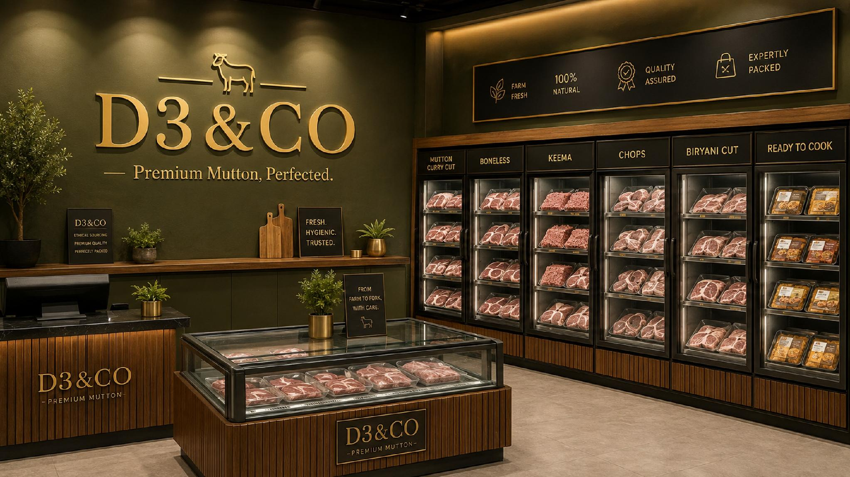
D3&CO
The focused path to India’s premium mutton brand.
Single-category focus creates a sharper launch story
Omnichannel model balances reach, margin and trust
Premium stores become fulfilment hubs and brand proof
Financial plan targets break-even after the pilot stage
Start with mutton. Build trust. Then own protein.
Investor discussion deck • projections are illustrative and should be validated with local procurement, platform and lease quotes.
12

